Slide 1
3. DEFINITION Cont…
Customers refer to such things as:
People waiting for open telephone lines
Machines waiting to be repaired
Aeroplanes waiting to land
People waiting in a checkout line at a supermarket

Slide 2
3. DEFINITION Cont…
Service facility refer to such things as:
Telephone lines
Repair shops
Airport runways
Check-out counters
Bank etc……

Slide 3
4. QUEUE CHARACTERISTICS
Queuing systems are characterised by 5 components:
The arrival pattern of customers
The service pattern
The number of servers
The capacity of the facility to hold customers
The order in which customers are served

Slide 4
5. ARRIVAL PATTERN
The arrival pattern of customers is usually specified by the arrival
rate [Arrivals can be measured as the arrival rate or the interarrival time (time between arrivals).
Interarrival time =1/ arrival rate ]
The arrival pattern may be deterministic or it may be a random variable with a known probability distribution.
It may depend on the number of customers already in the system, or it may be state-independent.

Slide 5
5. ARRIVAL PATTERN Cont’
May also depend on whether customers arrive singly or in batches, whether balking or reneging is permitted.
Balking: The customer may decide not to enter the queue upon Arrival, perhaps because it is too long.
Reneging: The customer may decide to leave the queue after Waiting a certain time in it.

Slide 6
Jockeying: If there are multiple queues in parallel
the customers May switch between them.
Drop-o®s: Customers may be dropped from the queue for reasons outside of their control. (This can be viewed as a generalization of reneging.)

Slide 7
6. EXAMPLES OF ARRIVAL RATES
The demand (or arrival rate) at a telephone exchange is 60 per minute.
Machine breakdowns (or arrivals at a repair facility) at a rate of 3 per week or 15 per month.
Aeroplanes arriving (requiring a runway) between 6 pm and 7 pm of one per minute.
Customers arrive at a checkout counter at the rate of 25 per hour.

Slide 8
7. SERVICE PATTERN
Usually specified by the service rate, i.e. the time required by one server to serve one customer.
The standard assumption is that one server can completely serve a customer.

Slide 9
8. EXAMPLES OF SERVICE RATES
A telephone systems between 2 cities can handle 90 calls per minute
A repair facility can, on average, repair machines at the rate of 4 per day.
An airport runway can handle (land) 2 planes per minute.
A checkout counter can process 1 customer every 4 minutes, on average.

Slide 10
9. SYSTEM CAPACITY
System capacity is the maximum number of customers, both those in service and those in the queue, permitted in the service facility at the same time.
Any customer arriving at a full facility is denied entrance.
Capacities can either be infinite or finite.
Congestion in queues can be caused by customers waiting in line when arrival rate > service rate, RESULT: Customers leave, bad image, revenue loss, etc.

Slide 11
9. SYSTEM CAPACITY Cont’
Over-capacity systems:
Service facilities may be empty (waiting for customers) because of too many service facilities or existing facilities.
Total service rate > rate of demand (arrival rate)
Critical issue: trade-off decision between the level of service
and the cost of waiting.

Slide 12
10. QUEUE DISCIPLINES
The queue discipline is the order in which customers are served.
EXAMPLES:
FIFO
LIFO
Random basis
Priority basis
Shortest processing time first (SPT)

Slide 13
Summary of assumptions in the queuing theory
The service is provided on a FIFO basis
Customers arrival is at random but at a given
average rate
The queuing system is in a steady state condition.

Slide 14
A number of arrivals at a facility per unit of time has a Poisson Distribution with mean
(m) and the rate of arrival (Y).
The time between consecutive arrivals (inter arrival time) has an experimental distribution with mean (X).

Slide 15
Symbols and notations:
n = total number of customers in the system, both waiting and in
service
µ = average number of customers being serviced per unit of time.
λ = average number of customers arriving per unit of time.
C = number of parallel service channels
Ls or E(n) = average number of customers in the system, both waiting in the service.
Lq or E(m) = average number of customers waiting in the queue

Slide 16
Ws or E(w) = average waiting time of a customer in the system both waiting and in service
Wq = average waiting time of a customer in the queue
Pn(t)= probability that there are n customer in the queue

Slide 17
Suppose we have the following
λ = Average arrival rate of customers in the system
µ = Average service rate of customers in the system.

Slide 18
We can derive the following:
Ls = Average number of customers in the system.
Lq = Average number of customers in the queue.
Ws = Average time a customer spends in the system.
Wq = Average time a customer spends in the queue

Slide 19
11. KENDALL’S NOTATION
Using Kendall’s notation, queue characteristics are specified by:
v/w/x/y/z
Where v = arrival rate, w = service rate, x = number of available servers, y = system capacity, z = queue discipline
If y or z are not specified, it is assumed that y = infinite capacity and z = FIFO

Slide 20
Queuing theory (Limitations)
Most of the queuing models are quite complex & cannot be easily understood.
Many times form of theoretical distribution applicable to given queuing situations is not known.
If the queuing discipline is not in” first in, first out”, the study of queuing problems become more difficult.
FORMULA
M/M/1 System

Slide 21
M/M/1 or M/M/1/∞: Single server queue with Poisson arrivals, exponentially distributed service times and infinite number of waiting positions.
M/M/m/ ∞ Queue (m servers, infinite number of waiting positions).
M/M/m/m Queue (m server loss system, no waiting)
M/M/1/K Queue (single server queue with K-1 positions)
waiting
M/M/1/-/K Queue (single server, infinite number of waiting positions, finite customer population K)

Slide 22
Assumptions:
Arrival process is Poisson with rate λ packets/sec
Packet transmission times are exponentially distributed with mean 1/μ
One server
Independent interarrival times and packet transmission times
Transmission time is proportional to packet length
μ=Service Rate λ= Arrival Rate
Note 1/μ is secs/packet so μ is packets/sec (packet transmission rate of the queue).
Utilization factor (Traffic Intensity): ρ = λ/μ (stable system if ρ < 1)

Slide 23
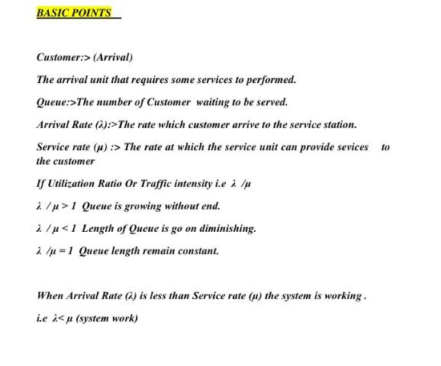

Slide 24

Little’s law
Little's Law says that, “under steady state conditions, the average number of items in a queuing system equals the average rate at which items arrive multiplied by the average time that an item spends in the system”.

Slide 25
Letting L =average number of items in the queuing system,
W = average waiting time in the system for an item, and
λ =average number of items arriving per unit time, the law is
L = λ W
For example, in a four-year college, in which (on average) 5000 first-year students enter per year, the average number of students present at this college is given by 5000 ×4 = 20, 000.

Slide 26

Assume customers arrive at the rate of 10 per hour and stay an average of 0.5 hour. This means we should find the average number of customers in the store at any time to be 5.
We can apply Little's Law to systems within the store.
For example, consider the counter and its queue. Assume we notice that there are on average 2 customers in the queue and at the counter. We know the arrival rate is 10 per hour, so customers must be spending 0.2 hours on average checking out.

Slide 27
Delay Calculation
Let
Q = Average time spent waiting in queue
T = Average packet delay (transmission plus queuing)
Note that T = 1/μ + Q(Waiting time in queue)
Also by Little’s law
N = λ T and N_{q} = λ Q
where
N_{q} = Average number waiting in queue

Slide 28
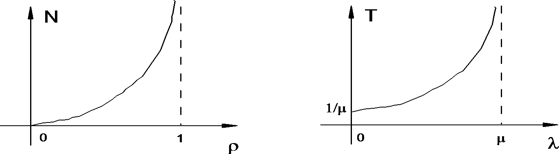
M/M/1 Results
The analysis gives the steady-state probabilities
of number of packets in queue or transmission
P{n packets} = ρ^{n}(1-ρ) where ρ = λ/μ
From this we can get the averages:
N = ρ/(1 - ρ)
T = N/λ = ρ/λ(1 - ρ) = 1/(μ - λ)

Slide 29
Example: How Delay Scales with Bandwidth
Assume:
Traffic arrival rate λ is doubled
System transmission capacity μ is doubled
Then:
Queue sizes stay at the same level (ρ stays the same)
Packet delay is cut in half (μ and λ are doubled)
A conclusion: In high speed networks
propagation delay increases in importance relative to delay
buffer size and packet loss may still be a problem

Slide 30
M/M/m, M/M/∞ System (Queue) [m servers, infinite number of waiting positions]
Same as M/M/1, but it has m (or ∞) servers
In M/M/m, the packet at the head of the queue moves to service when a server becomes free
Qualitative result
– Delay increases to ∞ as ρ = λ/mμ approaches 1
There are analytical formulas for the occupancy probabilities and average delay of these systems

Slide 31
M/G/1 System
Same as M/M/1 but the packet transmission time distribution is
general, with given mean 1/μ and variance σ²
Utilization factor ρ = λ /μ
M = exponential
Pollaczek-Kinchine formula for
Average time in queue = λ(σ² + 1/μ²)/2(1- ρ)
Average delay = 1/μ + λ(σ² + 1/μ²)/2(1- ρ)
(memoryless)
G = general
The formulas for the steady-state occupancy probabilities are more complicated
Insight: As σ² increases, delay increases

Slide 32
G/G/1 System
Same as M/G/1 but now the packet interarrival time distribution is also general, with mean λ and variance γ²
We still assume FIFO and independent interarrival times and packet transmission times
Heavy traffic approximation:
Average time in queue ~ λ(σ² + γ²)/2(1- ρ)
Becomes increasingly accurate as ρ→1

